Slide 1
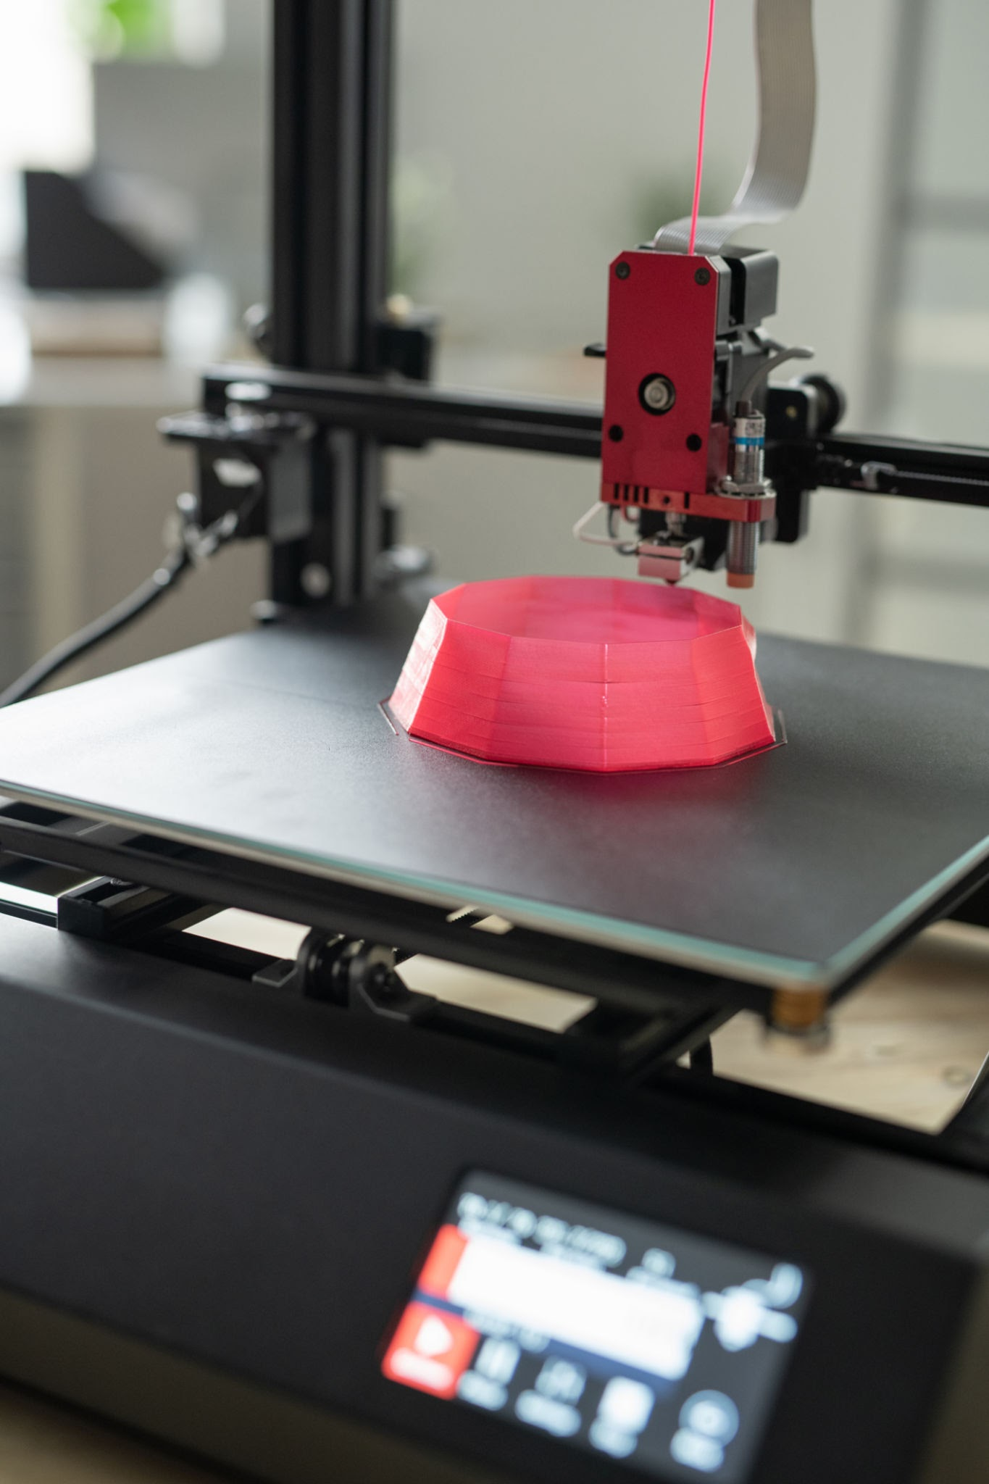
MAKING HISTORY
Integrating Maker Education into the Social Studies Classroom
＋
ADD A FEATURE PHOTO
Harrison Keenan | LDT 824 Final Project
Click this box, then Insert → Image
Notes:
Hi everyone, my name is Harrison Keenan, and my final project is called Making History: Integrating Maker Education into the Social Studies Classroom. For my project, I developed a practical plan for bringing maker education into a regular social studies classroom. My goal is to move beyond students only reading about history or looking at information on a screen and give them opportunities to create something connected to what they are learning. Throughout this project, I focused on realistic classroom activities including 3D printing, paper circuits, map making, historical artifact design, and other hands-on projects.

Slide 2
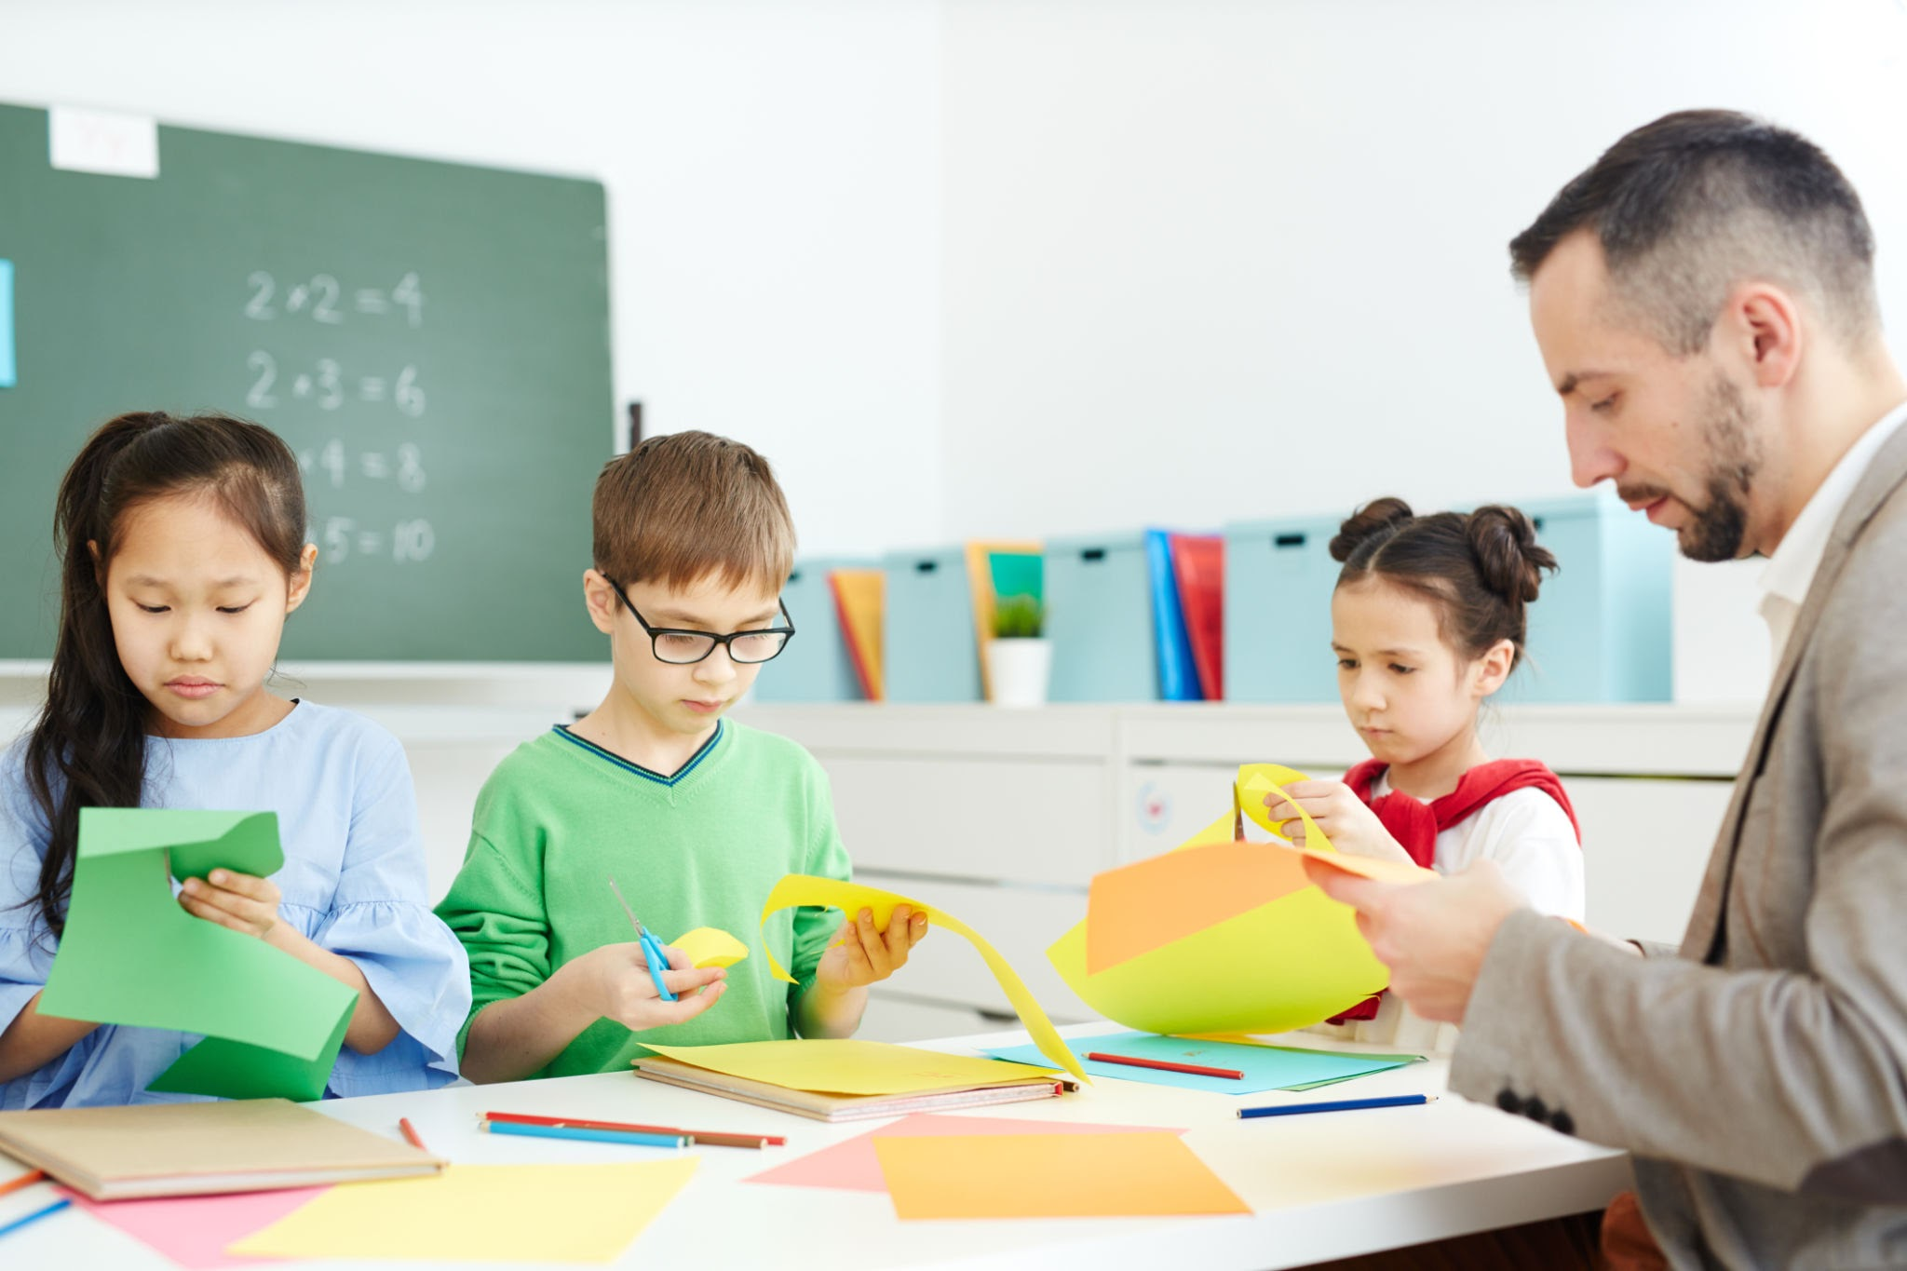
MAKING HISTORY
Making turns history into something students can touch
CREATE
EXPLORE
PROBLEM SOLVE
COLLABORATE
History becomes hands-on
Students make meaningful choices
Mistakes become part of learning
Learning ends with a visible product
＋
ADD A MAKING PHOTO
Click this box, then Insert → Image
02
Notes:
One reason I chose this project is because social studies can sometimes become too focused on reading, notes, worksheets, and memorizing information. Those things still have a place, but making offers another way for students to interact with the content. Instead of only learning about a historical object, place, or event, students can design something connected to it. Making also naturally includes problem solving. A student's first design might not work. Instead of treating that as failure, students can figure out what went wrong, make a change, and try again.

Slide 3
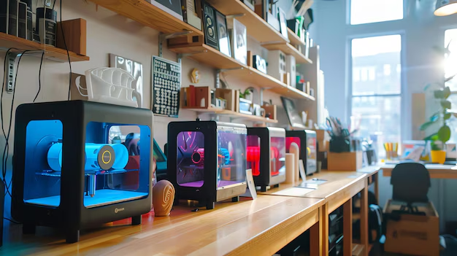
MAKING HISTORY
Middle school learners need ownership and purposeful tech
Designed for middle school social studies
Students need opportunities to create, make choices, work together, connect history to something tangible, and use technology for a clear purpose.
＋
ADD A STUDENT / CLASSROOM PHOTO
Click this box, then Insert → Image
Don’t just learn history. Make something from it.
03
Notes:
My project is designed primarily for middle school social studies students. At this age, students benefit from opportunities to move around, work with their hands, collaborate, and have ownership over what they create. It is also important to me that technology has a purpose. With maker education, technology becomes one tool in a larger process. Students can design something on a computer, but then print it, build it, test it, explain it, and discuss it face to face. That balance between technology and human interaction is a major reason this project matters to me.

Slide 4
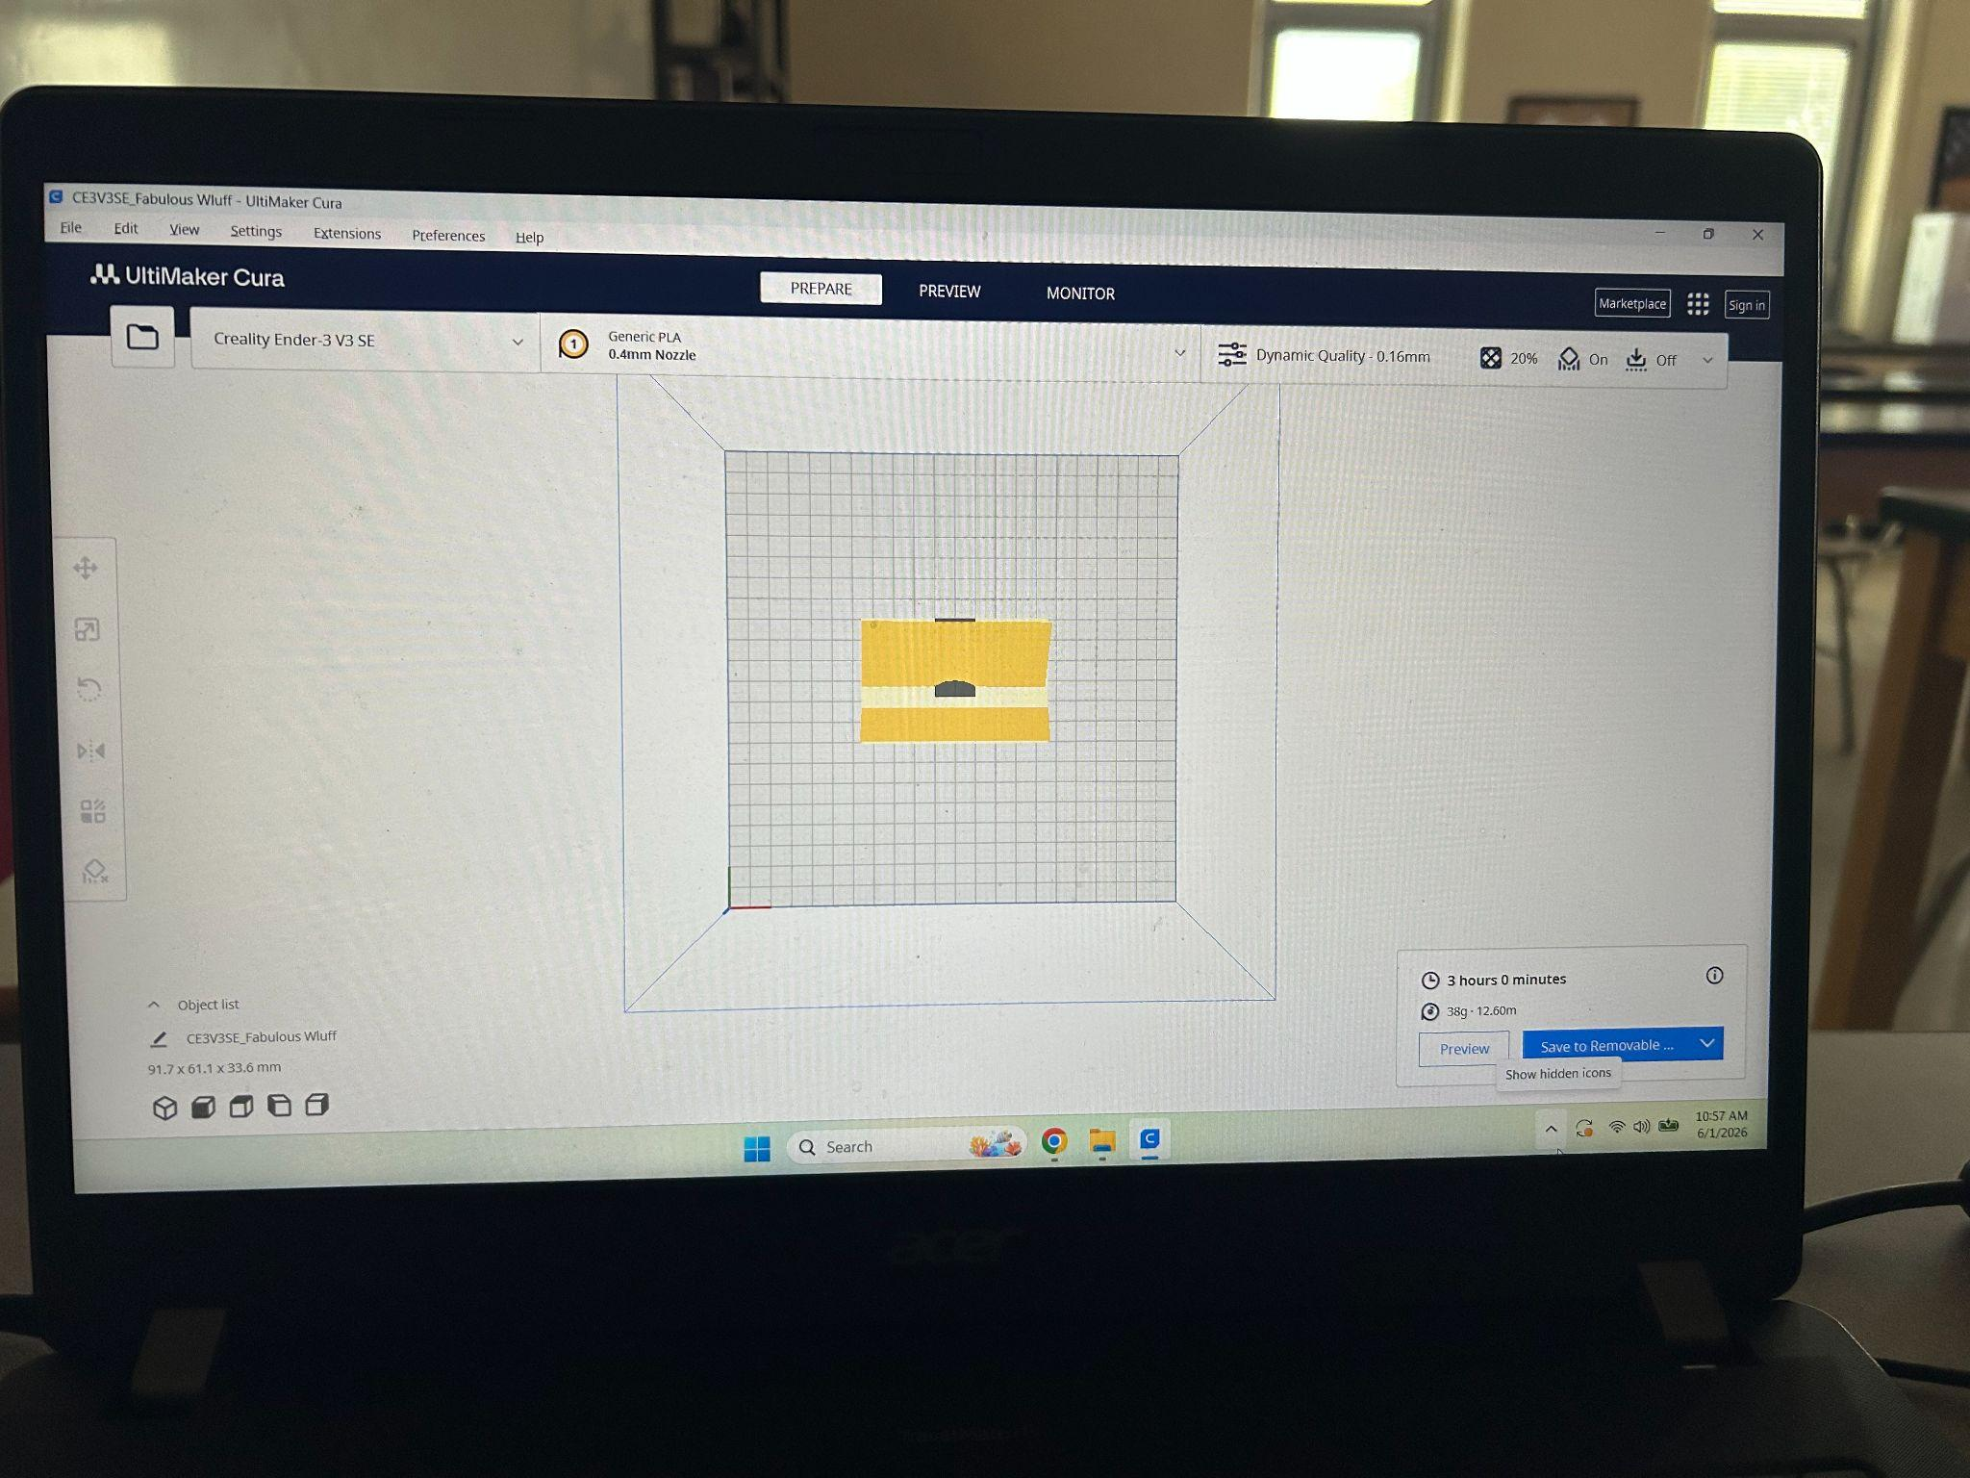
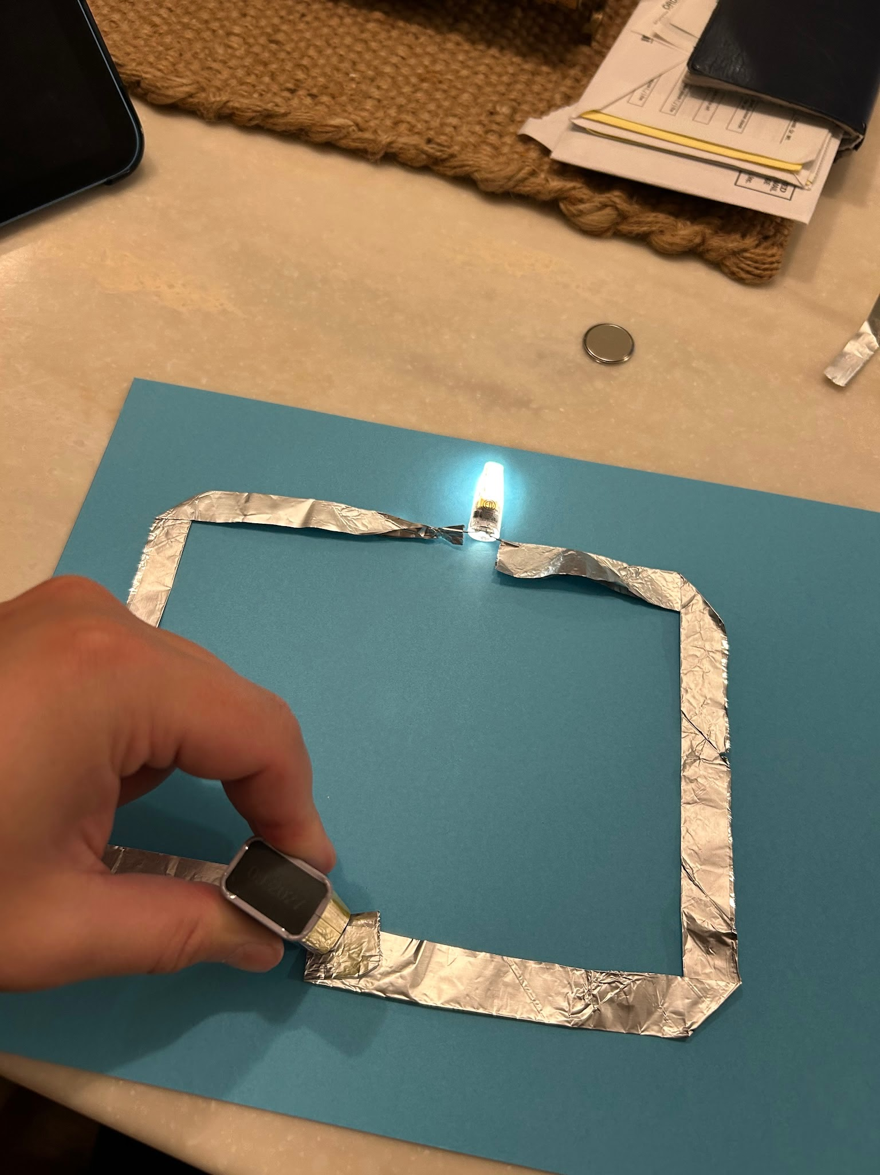
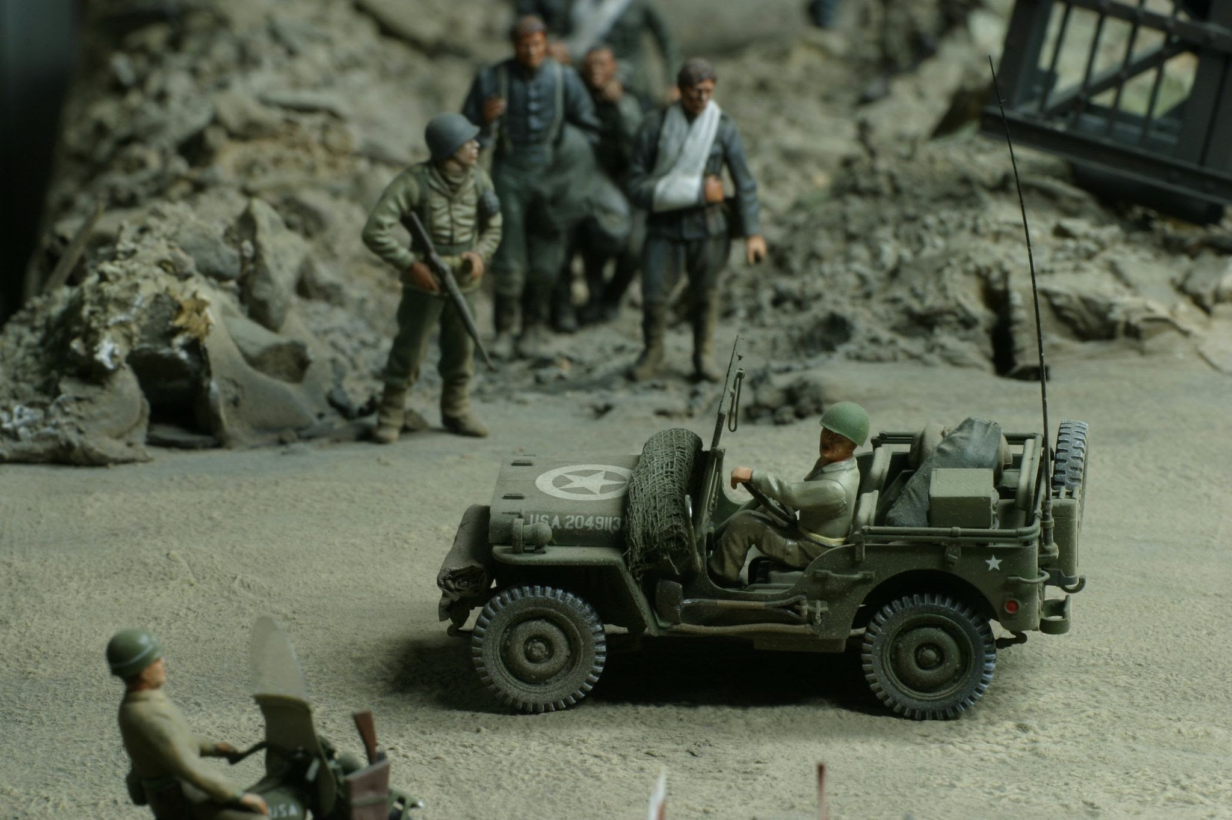
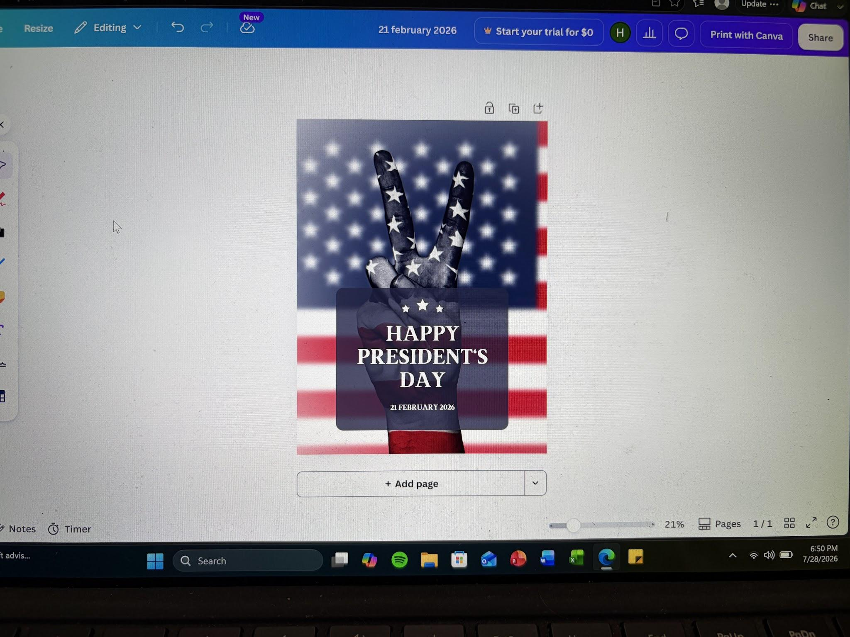
MAKING HISTORY
Students can make history with any level of technology
3D PRINTING
Artifacts • landforms • buildings • maps
＋
PAPER CIRCUITS
Interactive maps • historical displays
ADD PHOTO
ADD PHOTO
Click this box, t
PHYSICAL MAKING
Models • dioramas • prototypes
＋
DIGITAL MAKING
3D design • storytelling • research
＋
ADD PHOTO
ADD PHOTO
Click this box,
04
Notes:
This slide shows what my project could look like in the classroom. I intentionally did not design the makerspace around one piece of technology. Students could use 3D printing to create historical artifacts, buildings, physical features, or maps. They could use paper circuits to create an interactive historical or geographic map where LEDs identify important locations. Students could also build physical models or combine digital and physical tools. One student might use a 3D printer while another reaches the same learning goal with cardboard, paper, clay, or recycled materials. The goal is not one machine. The goal is deeper understanding through making.

Slide 5
MAKING HISTORY
Construction and personal interest deepen learning
1
CONSTRUCTIONISM
2
INTEREST-DRIVEN LEARNING
Ackermann (2001)
Renninger & Bish (2017)
Students construct understanding while creating a meaningful artifact.
Choice in topic, material, or product helps students connect with the content.
MAKE → TEST → REFLECT → IMPROVE
05
Notes:
Two course concepts had a major influence on my project. The first is constructionism. Ackermann's 2001 discussion of Piaget and Papert helped me think about learning as something students actively construct rather than something a teacher simply gives them. In maker education, students construct both their understanding and an actual artifact. The second is interest-driven learning from Renninger and Bish. Students do not need to create identical products to demonstrate the same learning. Giving them choice over a topic, material, or final product can help them connect their interests with the content.
[Sources]
Ackermann, E. (2001). Piaget's constructivism, Papert's constructionism: What's the difference?
Renninger, K. A., & Bish, S. (2017). Interest development and learning.

Slide 6
MAKING HISTORY
Facilitation and flexible materials make participation possible
3
TEACHER AS FACILITATOR
4
MATERIALS & ACCESS
Gerstein (2019)
Keune & Peppler (2019)
Ask → Guide → Support → Reflect
Multiple materials = multiple ways to participate
The teacher coaches students through problems instead of immediately fixing the project.
Paper, cardboard, recycled materials, circuits, and digital tools create different entry points.
06
Notes:
Two other course concepts influenced how I would run these activities. The third is Gerstein's work on maker education. The teacher becomes more of a facilitator by asking questions such as, What have you tried? or Why do you think that happened? before immediately fixing a project. My fourth connection is Keune and Peppler's work with makerspace materials. Their ideas made me think about accessibility because the materials we choose affect who can participate and what learning is possible. A makerspace does not require every student to use expensive technology. Paper, cardboard, copper tape, LEDs, recycled materials, and digital tools can all provide meaningful entry points.
[Sources]
Gerstein, J. (2019). Learning in the making. ASCD.
Keune, A., & Peppler, K. (2019). Materials-to-develop-with: The making of a makerspace. British Journal of Educational Technology, 50(1), 280–293.

Slide 7
MAKING HISTORY
An interactive PA map joins history with circuitry
1 RESEARCH
Choose a PA location or event
2 DESIGN
Plan the map and circuit
3 MAKE
Paper + copper tape + LED
4 TEST & IMPROVE
Troubleshoot the circuit
Click this box, then Insert → Image
5 EXPLAIN
Connect the creation to history
The light is not the final goal—the historical explanation is.
07
Notes:
Here is one example of how I could put the project into practice. Students create an interactive Pennsylvania history map. They begin by researching important locations connected to a historical topic or time period. They then design the map and use copper tape, a battery, and LEDs to illuminate important locations. The process requires students to test their circuit and troubleshoot problems. The project does not end when the light turns on. Students must explain why they selected each location and its historical significance. That keeps social studies at the center while making becomes the method students use to demonstrate learning.

Slide 8
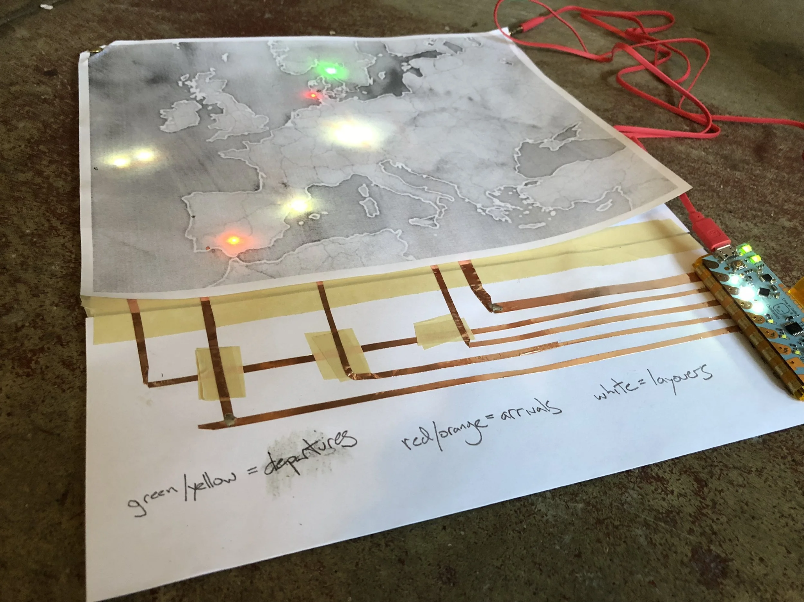
MAKING HISTORY
A makerspace is a learning environment, not equipment
CREATE
EXPERIMENT
＋
COLLABORATE
ADD A FINAL PROJECT PHOTO
FAIL SAFELY
Click this box, then Insert → Image
IMPROVE
SHARE
Making History turns students from consumers of information into creators of meaning.
08
Notes:
My biggest takeaway from this course is that a makerspace is not defined by how much technology is in the room. A 3D printer does not automatically create meaningful maker education. The important part is what students do with the materials and what they learn through the process. I want students to experiment, collaborate, make mistakes, improve their ideas, and create something they are proud to explain. For social studies, making can turn students from consumers of historical information into creators who use that information to build something meaningful. I would start with smaller activities like paper circuits and physical models, then gradually introduce more advanced tools such as 3D printing.

Slide 9
MAKING HISTORY
References
Ackermann, E. (2001). Piaget’s constructivism, Papert’s constructionism: What’s the difference?
Gerstein, J. (2019). Learning in the making: How to plan, execute, and assess powerful makerspace lessons. ASCD.
Keune, A., & Peppler, K. (2019). Materials-to-develop-with: The making of a makerspace. British Journal of Educational Technology, 50(1), 280–293. https://doi.org/10.1111/bjet.12702
Renninger, K. A., & Bish, A. L., (2017). Interest and interest-driven learning. In K. A. Peppler, (Ed.), The Sage encyclopedia of out-of-school learning. SAGE Publications.
09
Notes:
This final slide lists the course sources that informed the project. I would briefly acknowledge these references and then conclude the VoiceThread.
[Sources]
References displayed on slide.

